Slide 1
Real Time System (NCS-082)

Slide 2
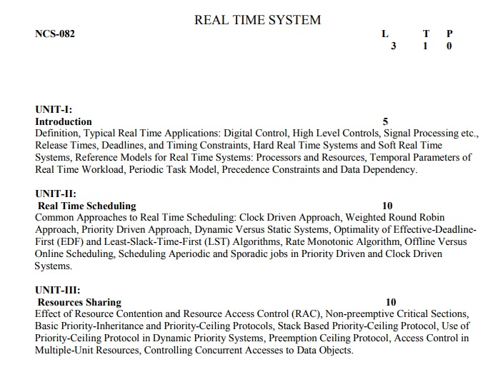

Slide 3
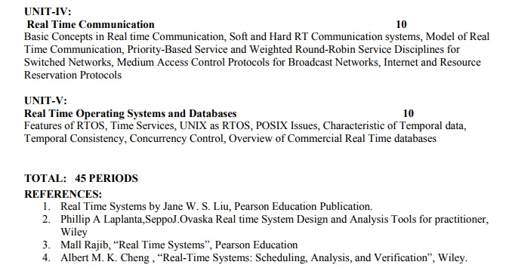

Slide 4
Prerequisites:
Operating System
Computer Network
DBMS

Slide 5
Real Time System
RTS
Real Time
System

Slide 6


Slide 7
There are two types of notion for time:
1) Quantitative:
It include any numeric value(number).
2) Qualitative:
Notion include words like after, before, sometimes, eventually, precedes, succeeds etc.

Slide 8

Quantitative Notion
When time is measured using physical clock(real).
Time is quantified using physical clock.
In every car we are getting air bags so whenever an accident occurred, that air bag has to be opened within a microseconds, so who will specify this time let us suppose it is 3msec, so we need a physical
clock.

Slide 9
Ex 2:
When the temperature of the chemical reaction chamber attains a certain predefines temperature say 250c,
System automatically switches off the heater within predefined time interval say within 30 msec.

Slide 10
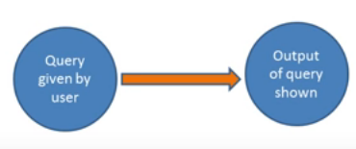
Qualitative Notion
When time is represented using before, after, sometimes etc.
Ex: When query given by user after that output of query is shown. In library system, a query book command is given by user, all matching books are displayed by software.

Slide 11
T
“System is called Real Time System, when we need quantitative notion of time to describe behavior of system.”
“A real-time systems is one in which the correctness of a result not only depends on the logical correctness of the calculation but also upon the time at which the result is made available.”

Slide 12
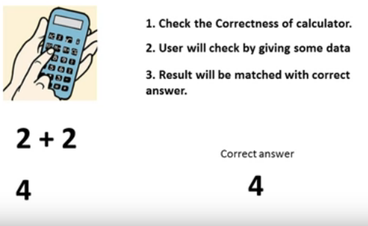
System
System needs to be correct.

Slide 13
Real Time System
System’s Correctness depends on function and timing constraint, applied on system.
Air bag deployment must be within 1-2 milli seconds after accident.
Case 1: If criteria is true then system is correct and pass
Case 2: If criteria is not true then system is failed as does’t meet criteria.

Slide 14
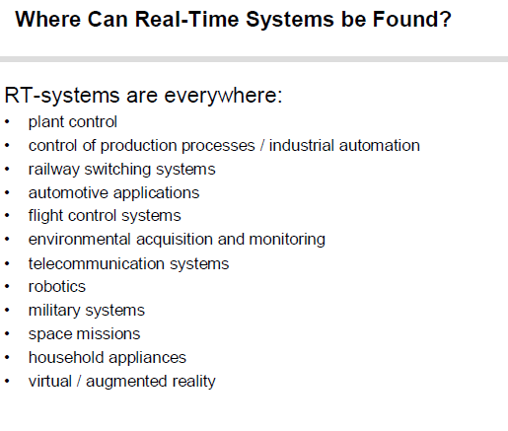

Slide 15
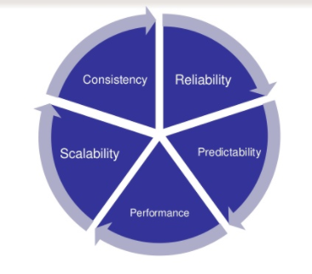
Characteristics of RTS

Slide 16
Types
Hard Real Time: Task is one that constrained to produce its result within certain predefined time bound. If deadline missed, system is considered as failed.
Firm Real Time: Task is one that required to produce its result within certain predefined time bound. If deadline missed, system is not considered as failed. Late result simply discarded.
Soft Real Time: Task also have time bounds associated with them. Time constraint is expressed as average value.

Slide 17
Thanku

